Slide 1


CMR TECHNICAL CAMPUS
UGC AUTONOMOUS
Accredited by NBA & NAAC with ‘A’ Grade
Approved by AICTE, New Delhi and JNTU Hyderabad
A
Real-Time Research Project On
AD CLICK FRAUD DETECTION USING MACHINE LEARNING AND DEEP LEARNING ALGORITHMS
BACHELOR OF TECHNOLOGY
In
COMPUTER SCIENCE AND ENGINEERING
GUIDE:
M Nagendra Rao
[Assistant Professor]
Presented by : (Batch: 9)
Patel Naveen Kumar(247R1A05B3) Kancharla Agni(247R1A0591)
K Kartheek(247R1A0597)

Slide 2
Contents:
Abstract
Introduction
Existing system and Limitations of existing system
Proposed system and Advantages of proposed system
Problem statement
Hardware and software requirements
Novelty of Project
System architecture
UML diagrams
Source Code
Results
Conlusion and Future Enhancement
References
Github Link

Slide 3
Abstract :
Click fraud is a major problem in online advertising.Bots and fake users generate invalid clicks.This causes financial loss to advertisers.
We propose a hybrid ML and Deep Learning system.
Tree-based models detect risky clicks quickly.LSTM models analyze user behavior over time.
The system improves accuracy and real-time fraud detection

Slide 4
Introduction:
Online advertising is important for digital business.
Click fraud wastes advertiser money.
Fraudsters use bots, scripts, and click farms.
Traditional systems cannot detect new fraud patterns.
Machine Learning and Deep Learning help analyze user behavior.
A hybrid system improves detection accuracy

Slide 5
Existing System:
Uses Deep Learning models like:
CNN – Analyzes complex user interaction patterns in click data.
DNN – Learns hidden patterns in large datasets to detect fraud.
RNN – Analyzes sequences of clicks to detect abnormal user behavior over time.

Slide 6
Detects fraud using:
IP Address – Identifies suspicious locations or repeated clicks from the same network.
Device Data – Checks device type, browser, and system details to find unusual activity.
Click Frequency – Detects bots by identifying very fast or repeated clicks.
User Behavior – Analyzes scrolling, mouse movement, and session activity to detect bots.

Slide 7
Limitations of the Existing System:
Cannot adapt to new fraud patterns.
Deep learning requires high computation.
Difficult to scale for large ad networks.
Models may miss new types of fraud.
Mostly monitor server-side data only.

Slide 8
Proposed system :
The proposed system is designed to detect and prevent click fraud using a combination of machine learning techniques and behavioral analysis. It integrates real-time detection with deep sequence modeling to ensure both speed and accuracy.
Introduces an Adaptive Hybrid Framework combining Machine Learning and Deep Learning
Detects click fraud using behavioral and temporal analysis
Processes user click data in real time
Multi-layer architecture improves detection accuracy It analyzes how users behave and how their actions change over time, allowing it to detect both simple and advanced fraud efficiently.

Slide 9
Data Collection:
IP address, device & browser details
Timestamp, click frequency
Session duration, user interaction patterns
Feature Engineering:
Click interval time
Clicks per session
Geographic patterns
User behavior metrics The system gathers detailed user activity data from multiple sources. This raw data is then transformed into meaningful features (like click speed or session behavior), which help the models easily identify unusual or suspicious activity.

Slide 10
Detection Layers
Machine Learning Layer:
Decision Tree, Random Forest, Gradient Boosting
Quickly identifies high-risk clicks
Deep Learning Layer:
LSTM (Long Short-Term Memory)
Detects:
Time-based patterns
Repeated click sequences
Bot-like behavior The first layer uses fast ML models to detect obvious fraud instantly. The second layer uses LSTM to analyze sequences of clicks over time, making it effective for detecting complex and hidden fraud patterns.

Slide 11
Advantages of proposed system :
High detection accuracy
Reduced false positives and false negatives
Real-time fraud detection
Ability to detect complex and evolving fraud patterns
Scalable for large dataset.
Combines interpretability of machine learning with the intelligence of deep learning
Adaptive learning capability

Slide 12
Problem Statement:
Click fraud is increasing due to bots and click farms.
Existing ML or DL models alone are not enough.
They fail to detect complex and evolving fraud patterns.
A hybrid and adaptive system is needed for real-time detection.

Slide 13
Hardware Requirements
Processor: Intel Core i5 or higher
RAM: Minimum 8 GB
Storage: Minimum 256 GB SSD
Internet connectivity for data collection & updates
Software Requirements
Operating System: Windows / Linux / macOS
Programming Language: Python
Development Tools: Jupyter Notebook / VS Code

Slide 14
Libraries & Frameworks
Pandas & NumPy → Data processing
Scikit-learn → Machine Learning
TensorFlow / PyTorch → Deep Learning
Matplotlib → Data visualization
Database & Backend
Database: MySQL / SQLite
Framework: Django
Handles data storage, routing & backend logic

Slide 15
Novelty of project
Hybrid ML + LSTM model for accurate fraud detection
Multi-layer system for simple and complex fraud patterns
Uses behavioral and temporal data together
Real-time detection with adaptive learning
Combines client-side and server-side analysis

Slide 16
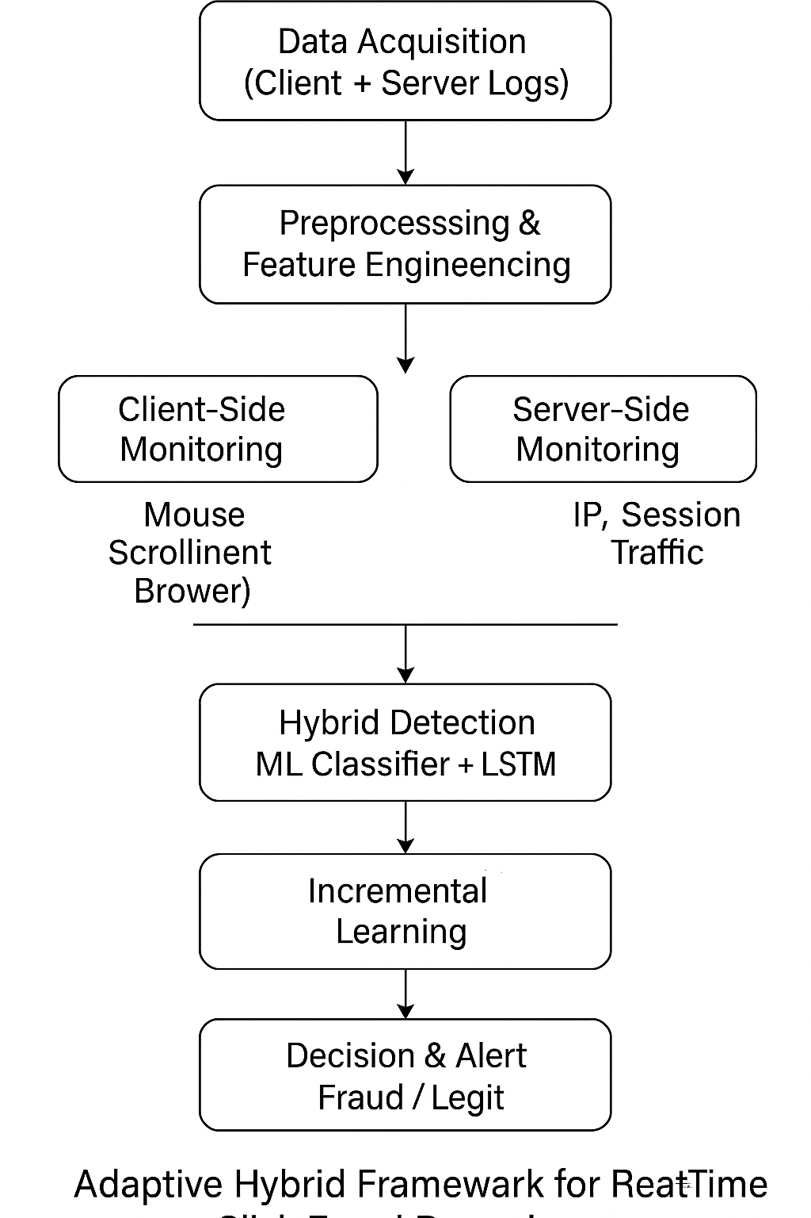
System architecture:

Slide 17
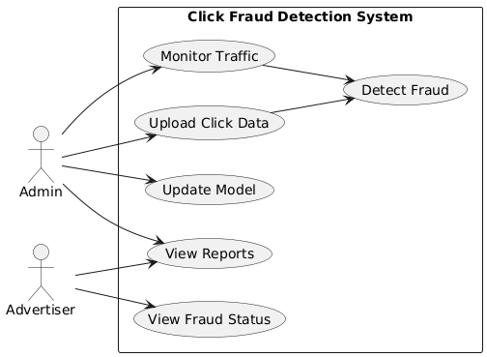
UML Diagrams: Use Case Diagram

Slide 18
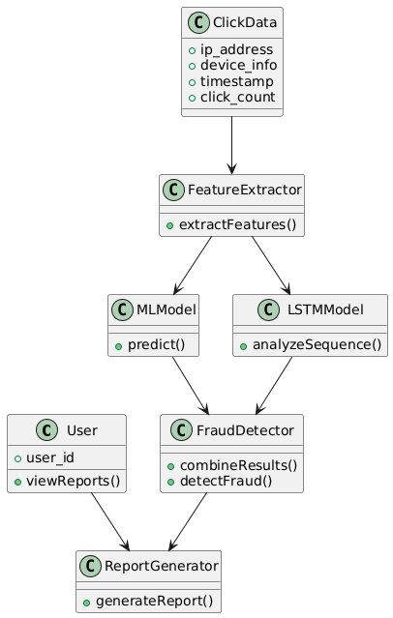
Class Diagram:

Slide 19
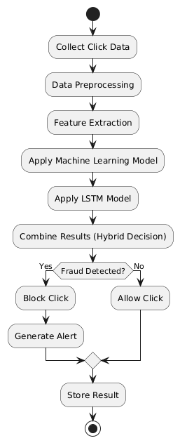
Activity Diagram:

Slide 20
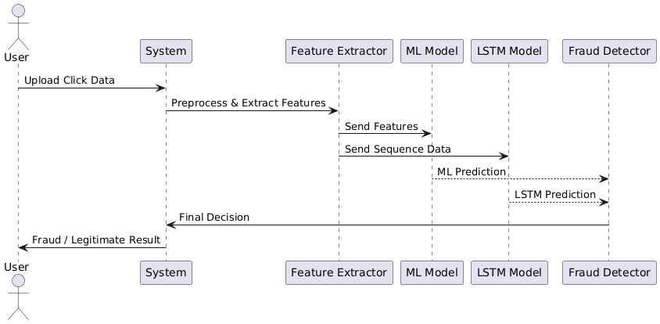
Sequence Diagram

Slide 21
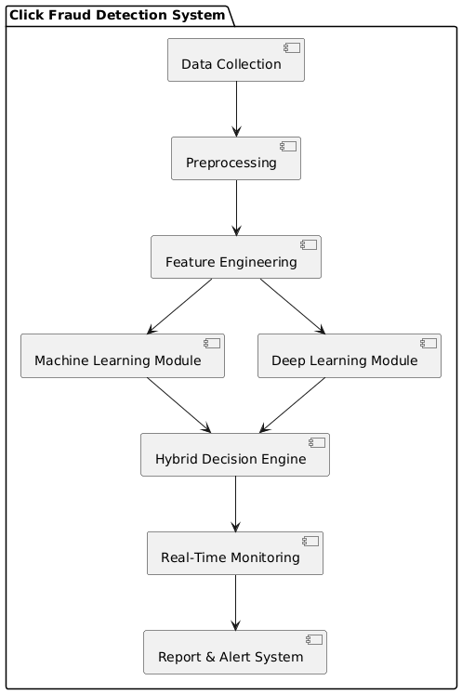
Component Diagram

Slide 22
Source Code:
manage.py
import os
import sys
def main():
os.environ.setdefault('DJANGO_SETTINGS_MODULE', 'clickfraud.settings')
try:
from django.core.management import execute_from_command_line
except ImportError as exc:
raise ImportError("Couldn't import Django") from exc
execute_from_command_line(sys.argv)
if __name__ == '__main__':
main()

Slide 23
settings.py
from pathlib import Path
BASE_DIR = Path(__file__).resolve().parent.parent
SECRET_KEY = 'django-secret-key'
DEBUG = True
ALLOWED_HOSTS = []
INSTALLED_APPS = [
'django.contrib.admin',
'django.contrib.auth',
'django.contrib.contenttypes',
'django.contrib.sessions',
'django.contrib.messages',
'django.contrib.staticfiles',
'detection',
]
MIDDLEWARE = [
'django.middleware.security.SecurityMiddleware',
'django.contrib.sessions.middleware.SessionMiddleware',
'django.middleware.common.CommonMiddleware',
]
ROOT_URLCONF = 'clickfraud.urls'
DATABASES = {
'default': {
'ENGINE': 'django.db.backends.sqlite3',
'NAME': BASE_DIR / 'db.sqlite3',
}
}

Slide 24
Project urls.py
from django.contrib import admin
from django.urls import path, include
urlpatterns = [
path('admin/', admin.site.urls),
path('', include('detection.urls')),
]
asgi.py
import os
from django.core.asgi import get_asgi_application
os.environ.setdefault('DJANGO_SETTINGS_MODULE', 'clickfraud.settings')
application = get_asgi_application()
wsgi.py import os from django.core.wsgi import get_wsgi_application os.environ.setdefault('DJANGO_SETTINGS_MODULE', 'clickfraud.settings') application = get_wsgi_application()

Slide 25
models.py
from django.db import models
class ClickEvent(models.Model):
device_type = models.CharField(max_length=50)
browser = models.CharField(max_length=100)
operating_system = models.CharField(max_length=100)
click_duration = models.FloatField()
mouse_movement = models.FloatField()
scroll_depth = models.FloatField()
keystrokes_detected = models.IntegerField()
click_frequency = models.IntegerField()
VPN_usage = models.BooleanField(default=False)
fraud_probability = models.FloatField(null=True, blank=True)
fraud_label = models.CharField(
max_length=10,
choices=[("fraud","Fraud"),("legit","Legit")],
null=True,
blank=True
)
timestamp = models.DateTimeField(auto_now_add=True)

Slide 26
admin.py
from django.contrib import admin
from .models import ClickEvent
admin.site.register(ClickEvent)
apps.py from django.apps import AppConfig class DetectionConfig(AppConfig): default_auto_field = 'django.db.models.BigAutoField' name = 'detection’
App urls.py
from django.urls import path
from . import views
urlpatterns = [
path('', views.home, name='home'),
path('training/', views.training, name='training'),
path('prediction/', views.prediction, name='prediction'),
]

Slide 27
views.py
from django.shortcuts import render
from .lstm import lstm_training
from .rfc import rfc_training
def home(request):
return render(request,"index.html")
def training(request):
rfc_accuracy = rfc_training()
lstm_model = lstm_training()
return render(request,"training.html",{
'accuracy': rfc_accuracy
})
def prediction(request):
result = "Prediction Result"
return render(request,"prediction.html",{
'result': result
})

Slide 28
Random Forest (rfc.py)
import pandas as pd
from sklearn.model_selection import train_test_split
from sklearn.preprocessing import LabelEncoder, StandardScaler
from sklearn.ensemble import RandomForestClassifier
from sklearn.metrics import accuracy_score
def rfc_training():
df = pd.read_csv("click_fraud_clened.csv")
df = df.dropna()
X = df.drop("is_fraudulent", axis=1)
y = df["is_fraudulent"]
for col in X.select_dtypes(include="object"):
X[col] = LabelEncoder().fit_transform(X[col])
X = StandardScaler().fit_transform(X)
X_train,X_test,y_train,y_test = train_test_split(X,y,test_size=0.2)
model = RandomForestClassifier()
model.fit(X_train,y_train)
predictions = model.predict(X_test)
return accuracy_score(y_test,predictions)

Slide 29
LSTM Model (lstm.py)
import pandas as pd
from sklearn.model_selection import train_test_split
from sklearn.preprocessing import LabelEncoder,StandardScaler
from tensorflow.keras.models import Sequential
from tensorflow.keras.layers import LSTM,Dense,Dropout
def lstm_training():
df = pd.read_csv("click_fraud_clened.csv")
df = df.dropna()
X = df.drop("is_fraudulent",axis=1)
y = df["is_fraudulent"]
for col in X.select_dtypes(include="object"):
X[col] = LabelEncoder().fit_transform(X[col])
X = StandardScaler().fit_transform(X)
X = X.reshape((X.shape[0],1,X.shape[1]))
X_train,X_test,y_train,y_test = train_test_split(X,y,test_size=0.2)
model = Sequential()
model.add(LSTM(64,input_shape=(1,X.shape[2]),return_sequences=True))
model.add(Dropout(0.3))
model.add(LSTM(32))
model.add(Dense(1,activation='sigmoid'))
model.compile(optimizer='adam',loss='binary_crossentropy')
model.fit(X_train,y_train,epochs=2)
return model

Slide 30
incremental_dataset.py
import pandas as pd
import os
DATASET_PATH = "datasets/click_fraud_incremental.csv"
def append_to_dataset(data):
df = pd.DataFrame([data])
if not os.path.exists(DATASET_PATH):
df.to_csv(DATASET_PATH,index=False)
else:
df.to_csv(DATASET_PATH,mode='a',header=False,index=False)
tests.py
from django.test import TestCase class BasicTest(TestCase): def test_home(self): self.assertEqual(1,1)

Slide 31
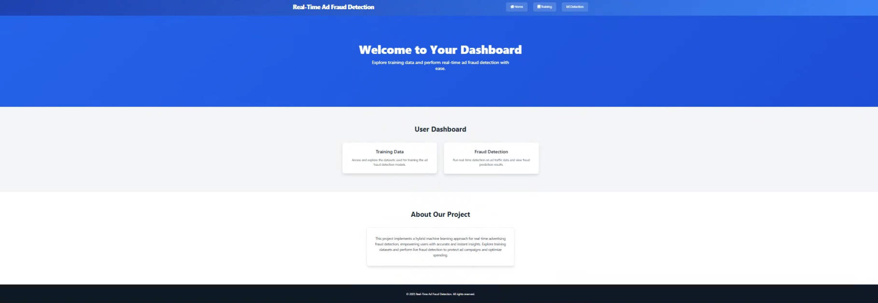
Results
Figure :Detection module image of Ad Click
FraudDetection Using Machine Learning And Deep Learning Algorithms

Slide 32
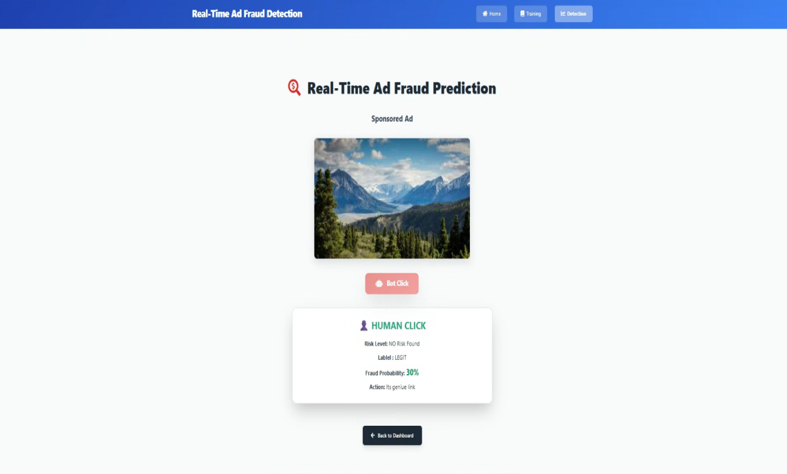
Figure :Human click detection image of Ad Click
FraudDetection Using Machine Learning And Deep Learning Algorithms

Slide 33
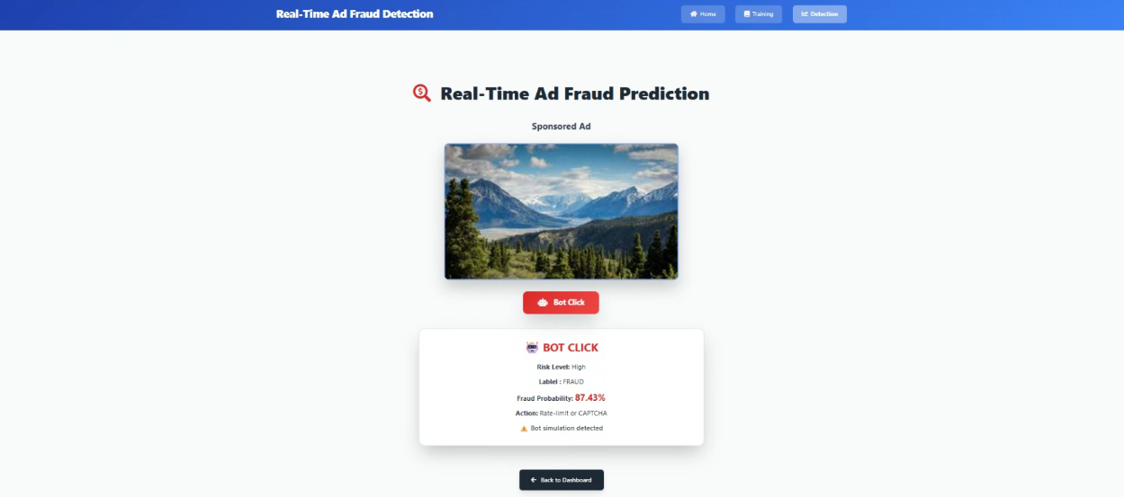
Figure :Bot click detection image of Ad Click
FraudDetection Using Machine Learning And Deep Learning Algorithms

Slide 34
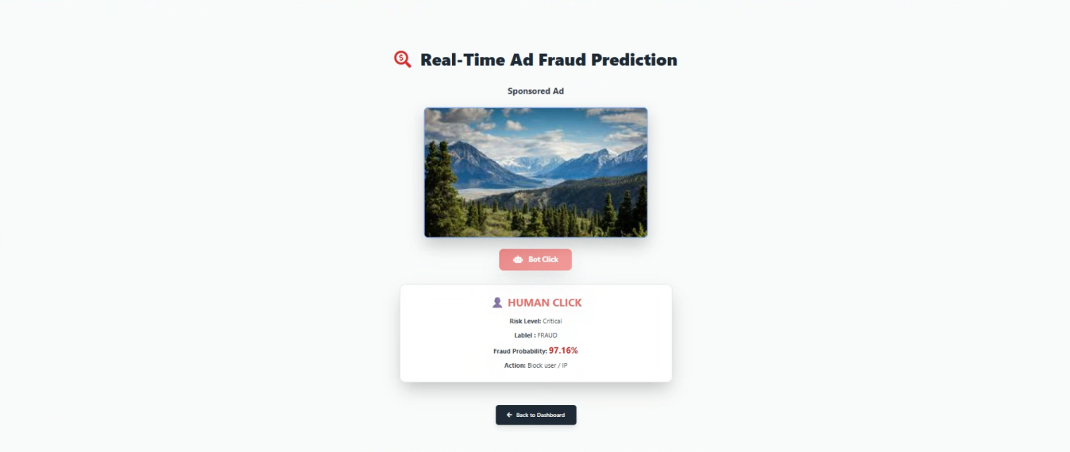
Figure : Multiple click detection image of Ad Click
FraudDetection Using Machine Learning And Deep Learning Algorithms

Slide 35

Figure :Model Training image of Ad Click FraudDetection Using Machine Learning And Deep Learning Algorithms

Slide 36
Conclusion:
Click fraud is a major problem in online advertising.
The proposed hybrid system uses Machine Learning and LSTM to detect fraud.
It analyzes user behavior and click patterns.
The system improves accuracy and real-time fraud detection

Slide 37
FUTURE ASPECTS
Future enhancements can significantly strengthen the system’s real-world effectiveness.
Integrating real-time streaming and cloud deployment will improve scalability and responsiveness.
Incorporating advanced models like Transformers and federated learning can enhance accuracy while preserving data privacy.
Continuous learning through automated model updates will keep the system adaptive to evolving fraud patterns.
Additionally, dashboards and richer behavioral features will support better monitoring and decision-making.

Slide 38
References
Kumar, A., & Sharma, R. “Machine Learning Approaches for Click Fraud Detection.” IEEE Access.
Patel, S., & Mehta, R. “Deep Learning-Based Analysis of User Interaction for Fraud Identification.” ACM Digital Library.
Zhang, M., Chen, L. “Sequential Modeling Techniques for Detecting Click Fraud Using RNN.” Springer.
Roy, J., & Das, S. “Hybrid ML Framework for Online Advertising Fraud Detection.” Elsevier.
Nguyen, T., & Lee, J. “Client-Side Behavioral Tracking for Real-Time Fraud Prevention.” IEEE Transactions on Information Forensics.
Wang, P., & Li, H. “Gradient Boosting Models for Advertising Fraud Detection.” Journal of Big Data.
Verma, A., & Singh, R. “Real-Time Ensemble Classification for Click Fraud Detection.” International Journal of Data Science

